Slide 1
Efficient Attendance Monitoring Using
AI-Based Face Detection
Nicholas Marshall, Nivedita Prabhu, Frank Diabour, Matthew Willingham, Ayodeji Adeogun

Slide 2
Group Members
Nivedita Prabhu
Nicholas Marshall
Ayodeji Adeogun
Frank Diabour
Matthew Willingham
Computer Science, Mathematics, Software Engineering
Computer Science
Computer Science, Software Engineering
Computer Science
AI/ML, Prototyping
Computer Science
Software Engineering

Slide 3
OverVIEW
Introduction
Motivation
Project Implementation
Model Training and Image Augmentation
Data Collection
Diagrams
Database System
Website UI
Demo+Summary

Slide 4
Introduction
AI has transformed education, workplace management, and security. This paper proposes an AI-driven attendance system using computer vision and machine learning for real-time face recognition. A deep learning model detects faces, matches them with a database, and records attendance automatically. Which can be accessed through a web interface which allows the user to run the operation and review the data generated.
Ayodeji Adeogun

Slide 5
Motivation
Why This Project?
Tracking attendance in large classrooms is challenging and error-prone. Professors struggle with accuracy, leading to misrepresentation. Traditional methods are slow, inefficient, and easily manipulated. Our intent is to generate a fast paced and accurate solution to this issue by, creating a seamless attendance tracking method for large classrooms.
Ayodeji Adeogun

Slide 6
Project Implementation
Data Collection
Data Collection, images, student ID, converting images into trainable formats(JPEG,JNG, and others
Research
Model Training and Image Augmentation
Model Training and Image Augmentation
Database System [Store Attendance]
Storing and managing database of student records and attendance.
Schema will consist of database for attendance, database for the trained model, and a website to access attendance tracking and upload attendance images for scoring
System Integration [Model+Schema+UI]

Slide 7

Model Training and Image Augmentation
Models Considered: YOLO, ResNet, SSD
Model Selection Reasons: Lightweight, fast, smaller dataset Requirement.
Image Augmentation: tilt, grain, exposure, brightness and other filter helps increase the confidence rate. A script will be deployed to augment. This includes some variations( angles, Tilt, occlusion,etc)
UPDATE: DEEP FACE MODEL
Frank Diabour

Slide 8
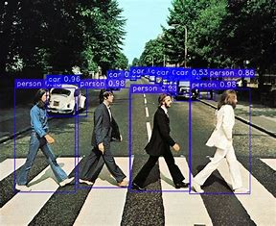
Data Collection
For data collection we are using DeepFaceRecognizer to identify the objects or in this case the faces we scanned using the YOLO model.
Collecting images from YOLO v8 then DeepFace compares the images side by side to test for similarities.
Ensuring format compatibility, converting images to a standard one like JPEG or PNG. Making sure the image format is standardized.
Labeling images with Student IDs, names, or other identifiers to create a structured dataset.
Main Image here
Matthew Willingham

Slide 9
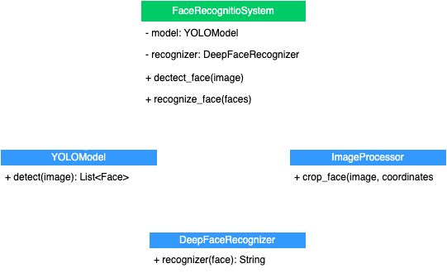
Class Diagram
Models face recognition with FaceRecognitionSystem, YOLOModel, and DeepFaceRecognizer.
ImageProcessor handles face cropping.
Shows detection → recognition flow.
Willingham

Slide 10
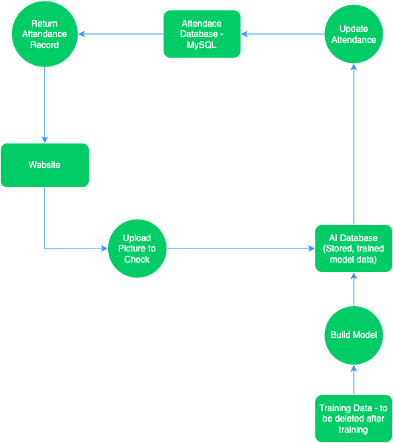
Sequence Diagram
Website - interact with attendance records and upload images to check
Attendance Database - see ER diagram
AI Database - holds trained data
Training Data - will be used to train the model then be deleted
Matthew Willingham and Nivedita Prabhu

Slide 11
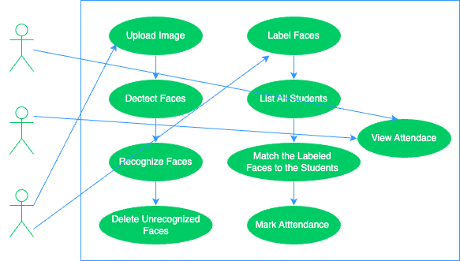
Use Case Diagram
Teachers upload images, detect and recognize faces, label them, match them to students, mark attendance, and view it.
The students can view the attendance
The developer role is involved in system maintenance or improvements, while students view the results.
Nivedita Prabhu

Slide 12
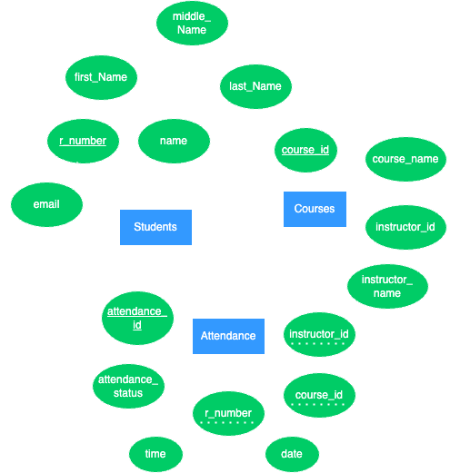
Er Diagram
Students, Courses, Attendance tables.
r_number links Students → Attendance.
course_id links Courses → Attendance.
Nivedita Prabhu

Slide 13
DataBase
Database Example
Previously in Stage 1, it was combined into one set of tables and columns, but I needed to split it into individual categories.
True/False instead of a checkbox for easier coding as it’s a boolean variable.
Changing values to better fit the data.
As we don’t currently have access to a full database of everyone in this class, i’m just using us for the data.
Nivedita Prabhu

Slide 14
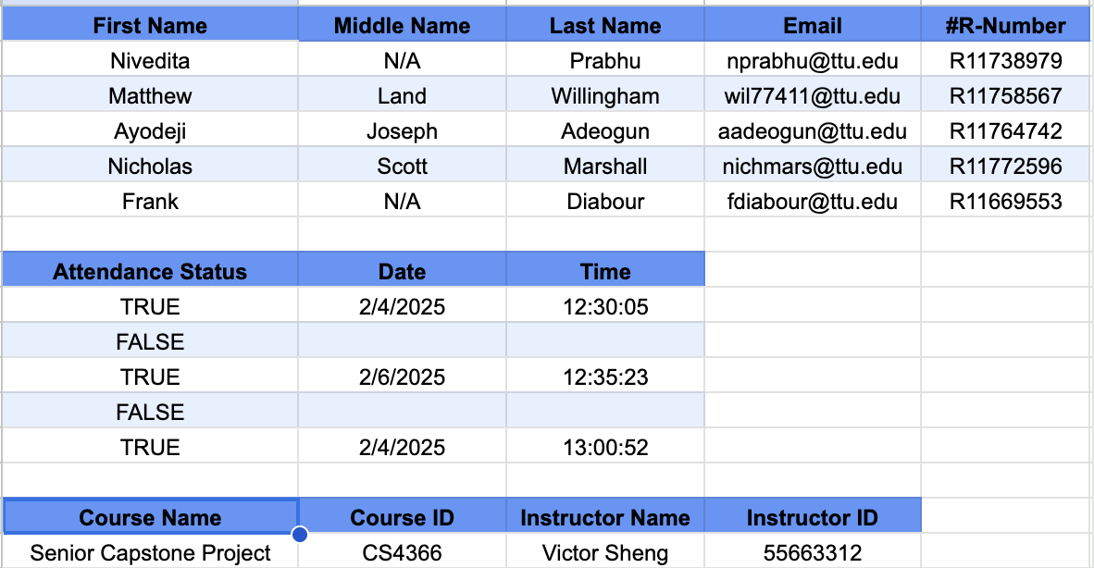
Database Example Table

Slide 15
Mysql Code summary and Example
CREATE TABLE Courses (
course_id INT(4) PRIMARY KEY NOT NULL,
course_name VARCHAR(100) NOT NULL,
instructor_id INT(8) UNIQUE NOT NULL,
instructor_name VARCHAR(100) NOT NULL
);
INSERT INTO Courses VALUES
(4366, 'Senior Capstone Project', 55663312, 'Victor Sheng');
SELECT 'Courses Table' AS Section;
SELECT * FROM Courses;
SELECT '';
Since we don’t have much data, I mainly imported it.
Create entities
Define Attributes
Insert Data
Show Data
Nivedita Prabhu

Slide 16
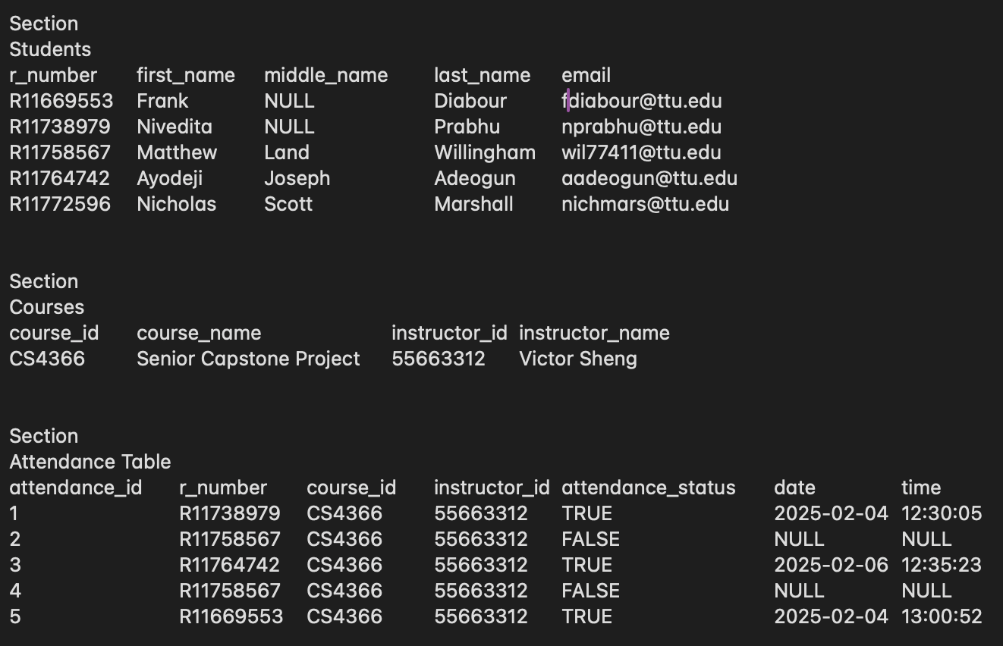
Mysql Database Output

Slide 17
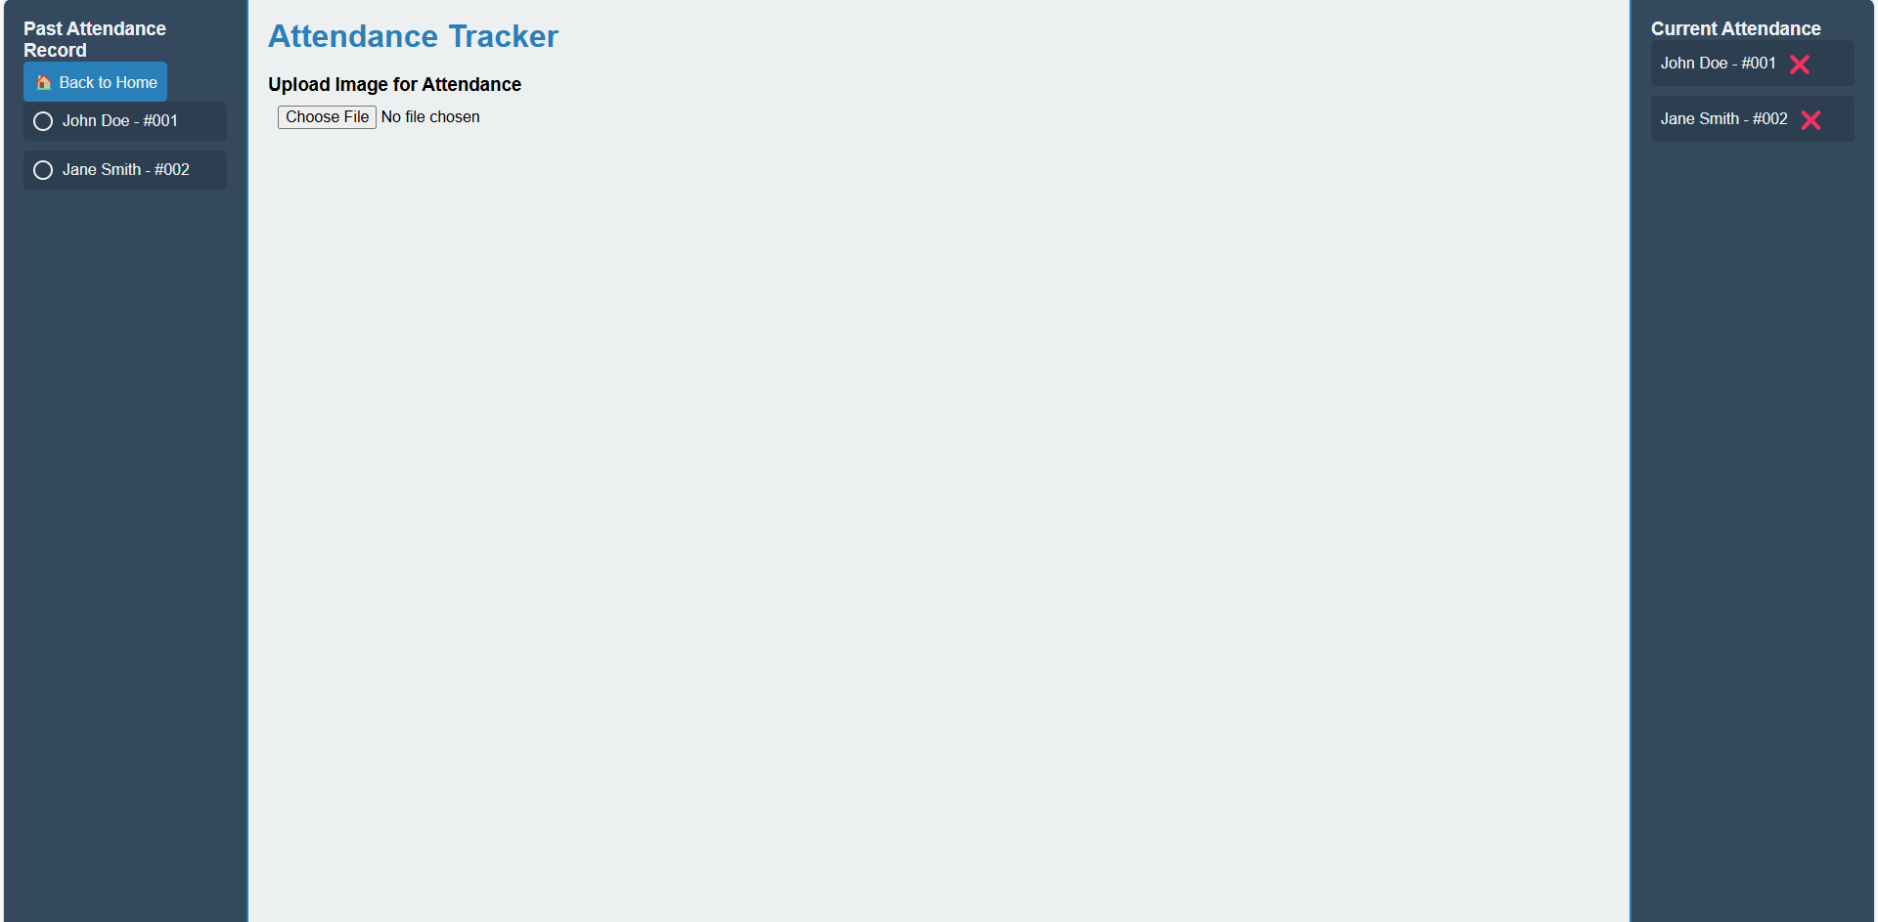
Website - UI
Nicholas Marshall

Slide 18

UI Connection with Flask - Database and Executable
Flask allows for communication with MySQL database
Flask will also enable attendance checker to run the actual face detection scripts which will then update database

Slide 19
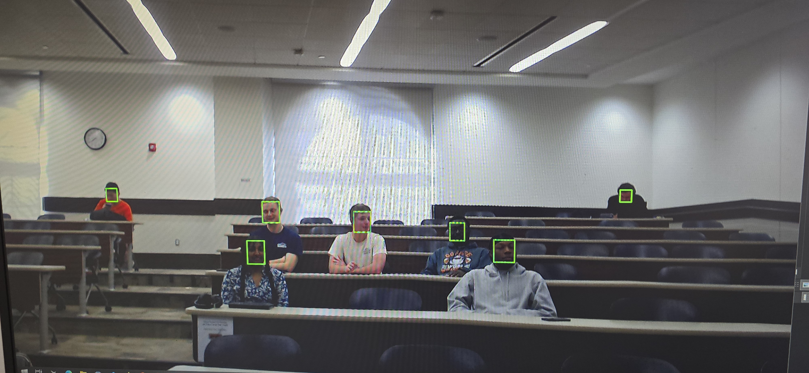
DEMO/ RESULT
STAGE 1 testing

Slide 20
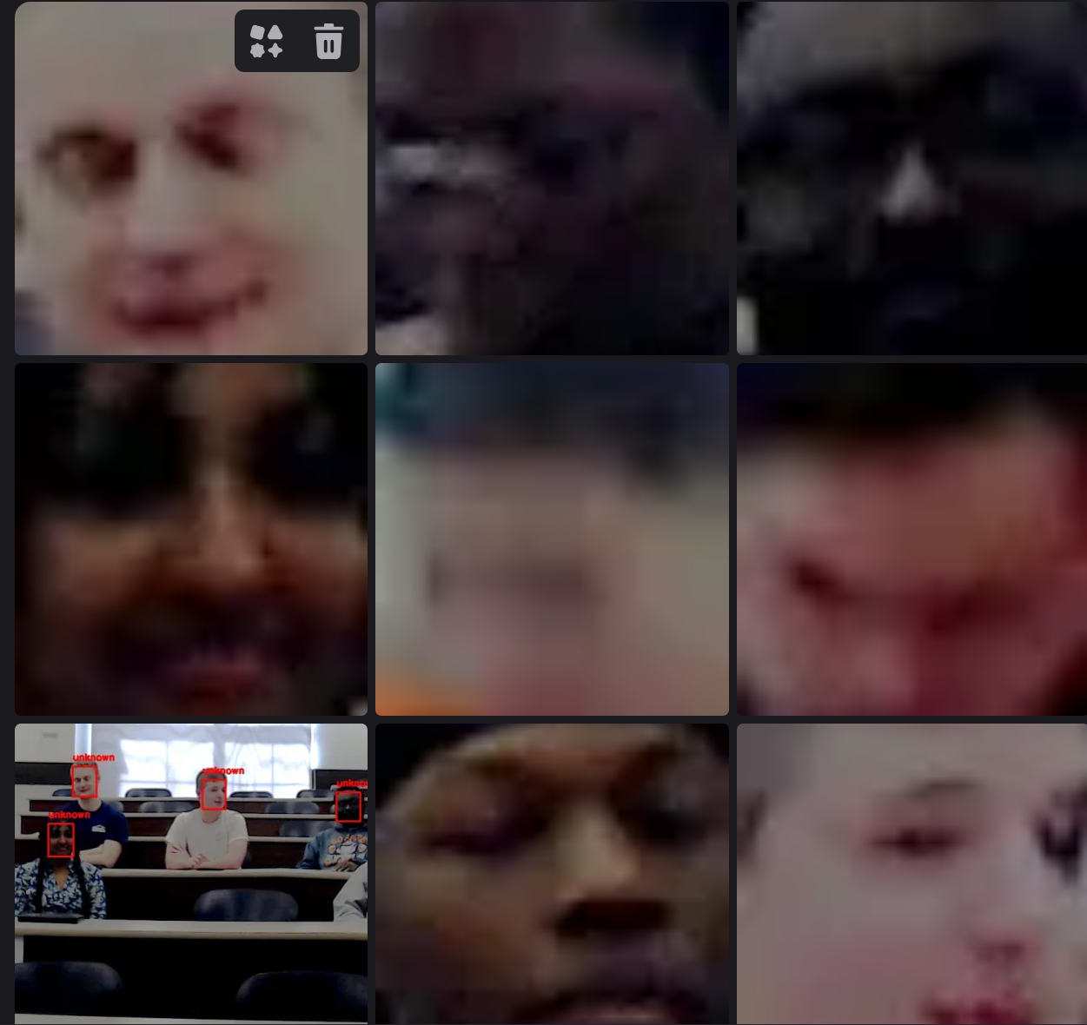
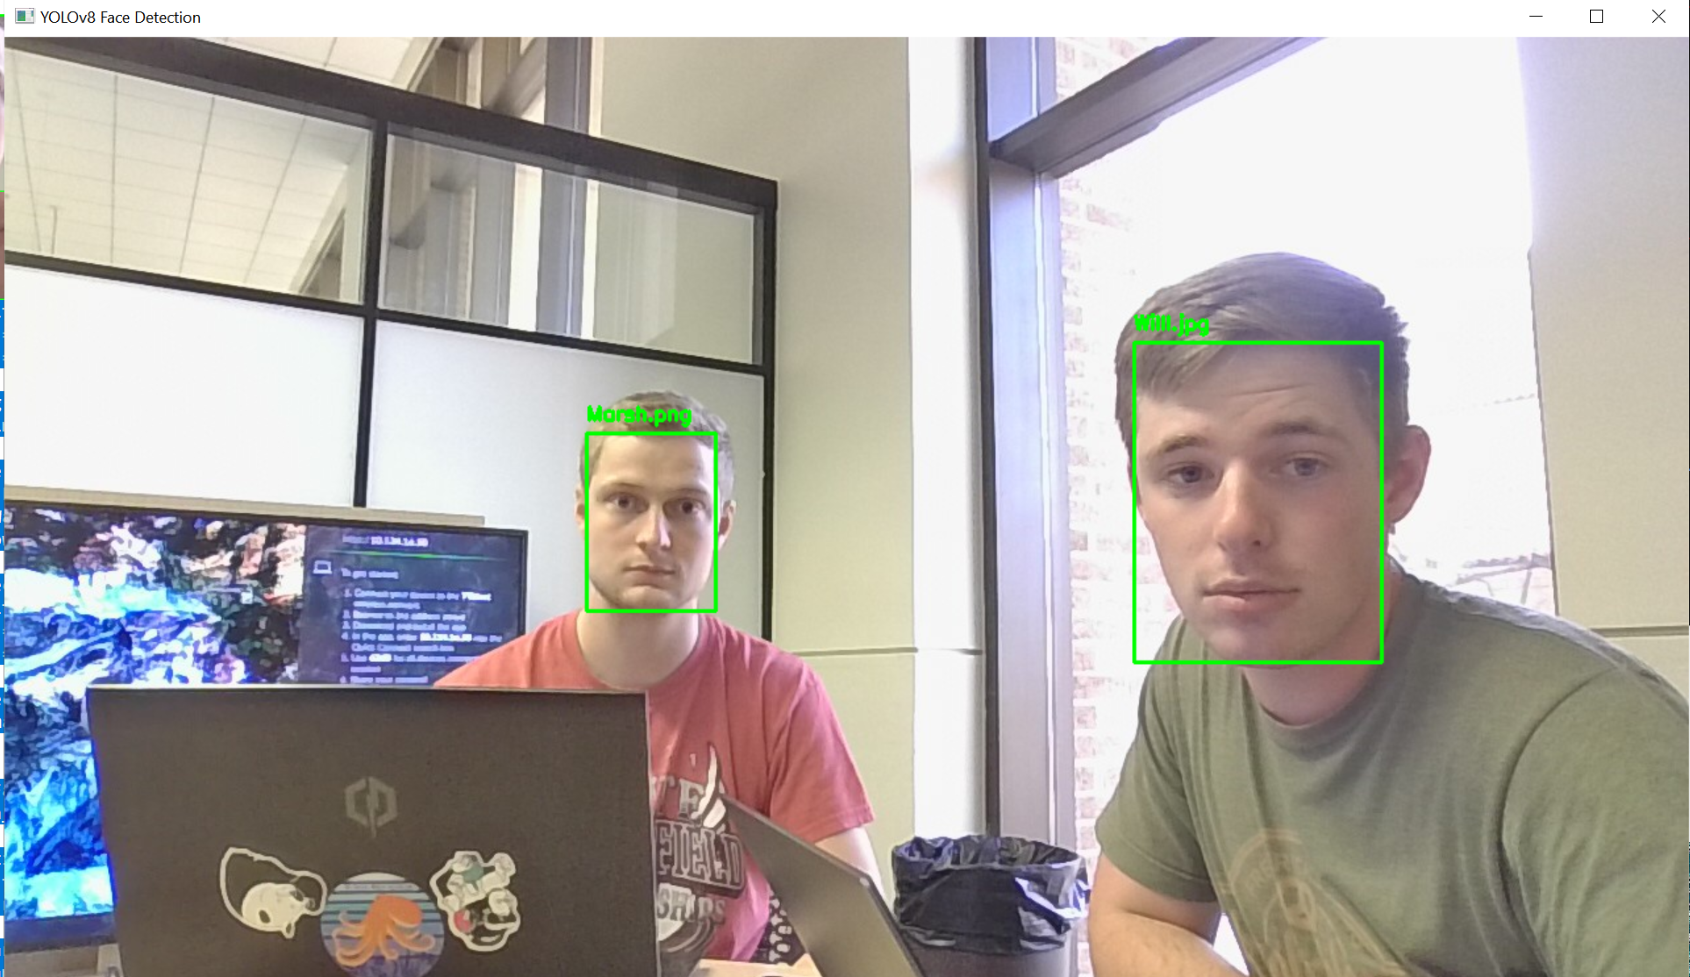
Current rEsults

Slide 21
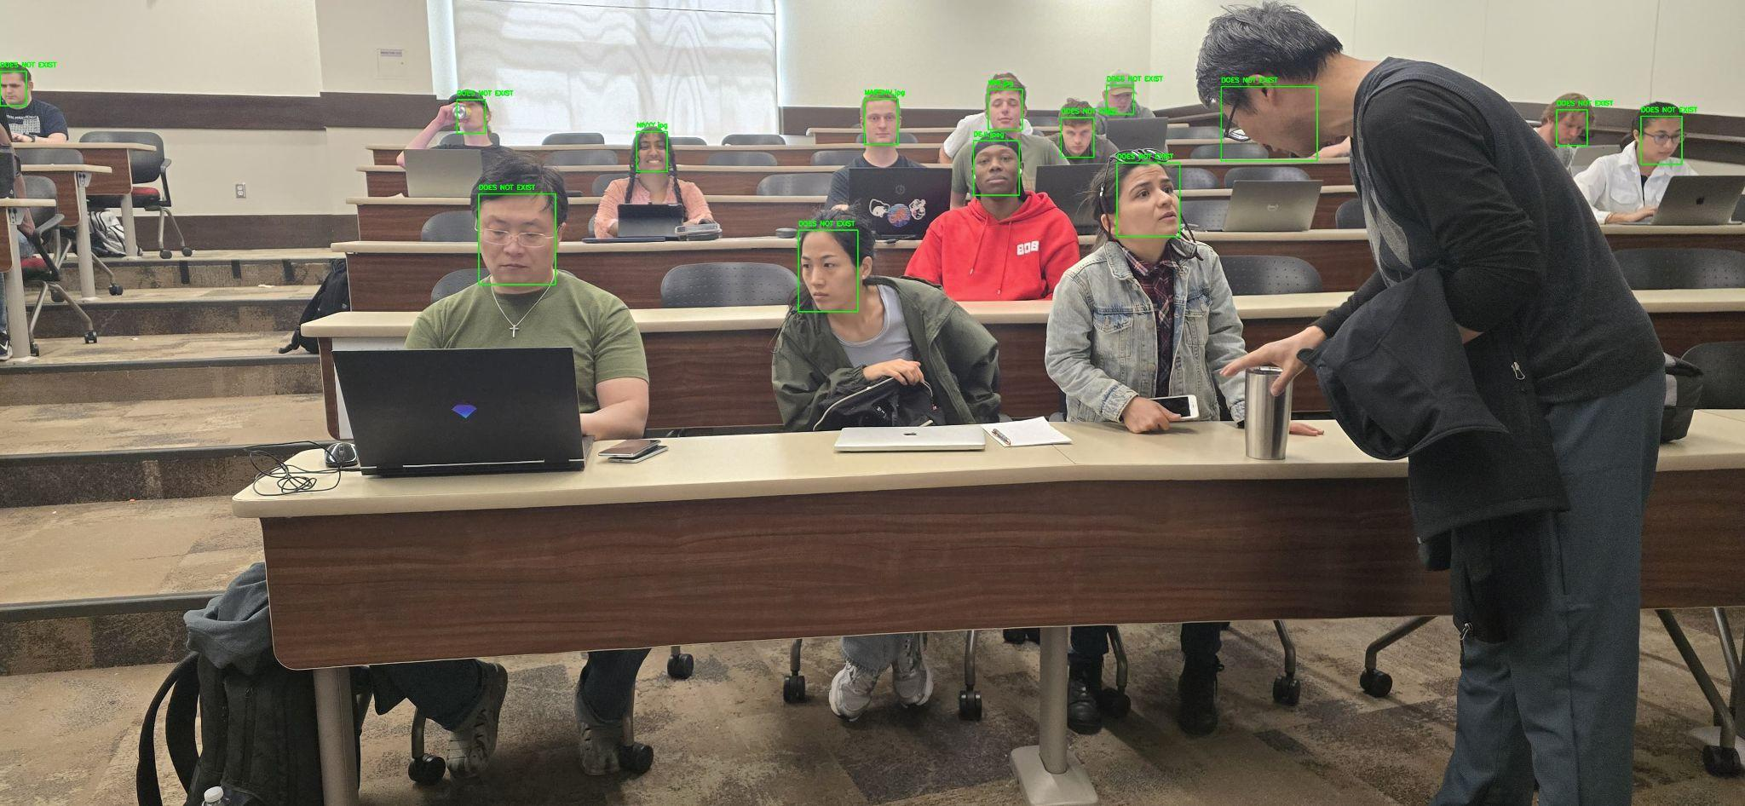
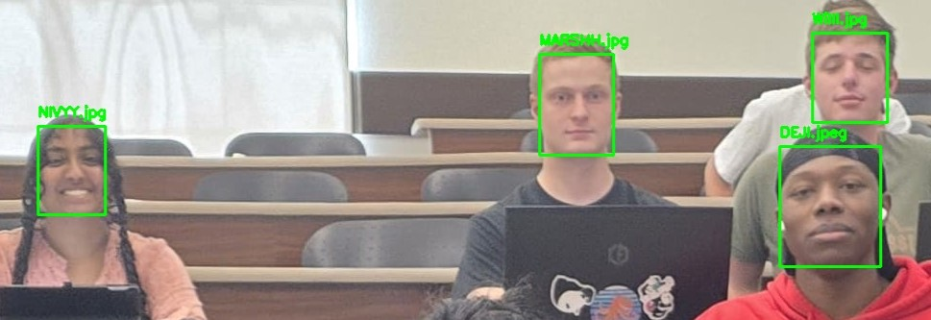
DEMO

Slide 22
Possible updates
Expand Recognized/Known faces (Dataset for DeepFace)
Real Time from a webcam (Better Quality)
Send an email for notification
Improve UI and UX

Slide 23
SUMMARY
Introduction
Motivation
Project Implementation
Model Training and Image Augmentation
Data Collection
Diagrams
Database System
Website UI

Slide 24
Thanks!
Q&A

